Slide 1


STYLE HIVE Fashion & Lifestyle
Sai divya sree(Project Manager) Sai vyshnav(Lead Developer) Priyanshu(Jenkins Admin) Susmitha (Lead BA) Lokesh (Product Owner)
Yeshwanth (Jira Admin) Avinash(Lead QA)
Rithika (Software tester )
Deepak (Developer)
Nikunj(DBA)

Slide 2
BUSINESS RELATIONSHIP MANAGEMENT (Sai divya sree )
SUPPLIERS
INTERNAL OPERATIONS
CUSTOMERS
Internal Stakeholders
Product Management
(Stylehive)
Advertising Partners
Customer Support
(StyleHive)
Basic Users
(Stylehive)
Logistics
Advertising Management
(Stylehive)
Premium Subscribers
(Stylehive)
Internal Operations directly interact with customers
Payment Processors
Finance Management
(Stylehive)
E-commerce management and product vendors
E-commerce Management
(StyleHive)
Data Providers and analytics tools
Data Analyst
(Stylehive)
Supply Chain Partners and Transportation providers
Supply Chain Management
(Stylehive)

Slide 3
Context Diagram (Yeswanth)
2
Product Data Integration
1
AD Management
Users(Basic/Premium Users)
User authentication , interacts with the platform to buy and manage orders
Accountant
Manages and tracks advertising on platforms
Product data for integration and uniqueness
3
Style Hive
Payment gateway , verifies payment and card info
Payment Gateway
Manages shipping and delivery
Manages the query details of users
6
Stock availability
4
Supply chain Management
Customer Support
Inventory management
5

Slide 4
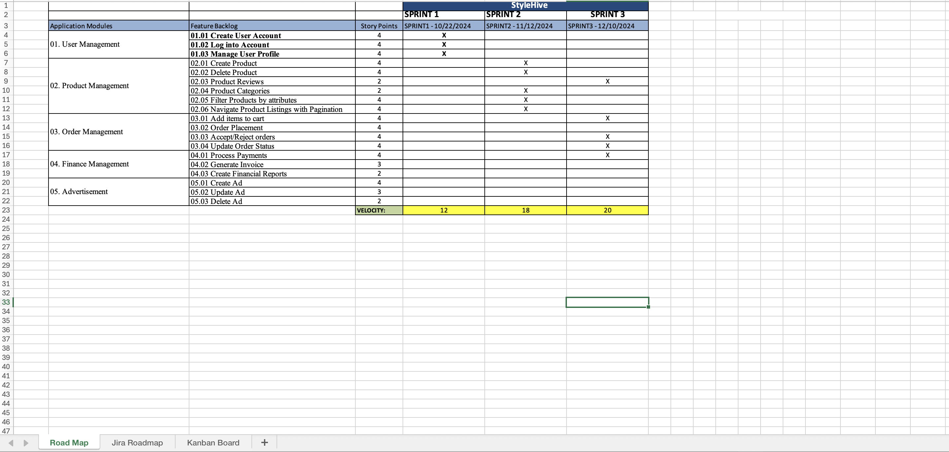
Road Map
(Lokesh)

Slide 5
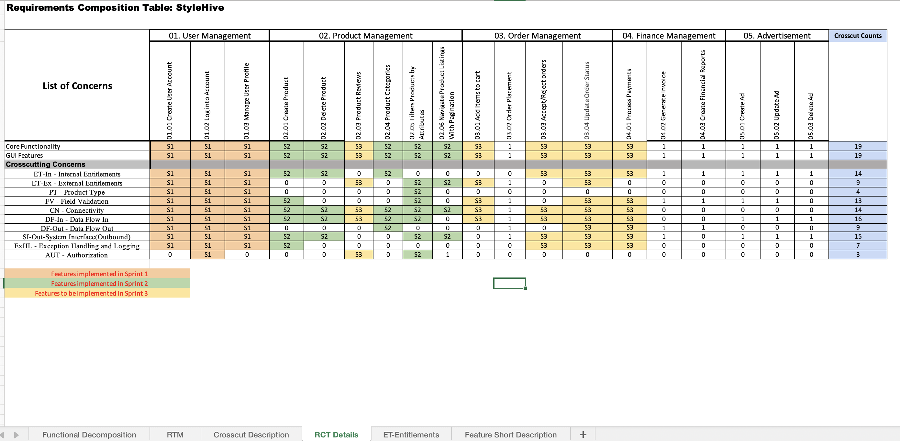
RCT (Main View)
(Rithika)

Slide 6
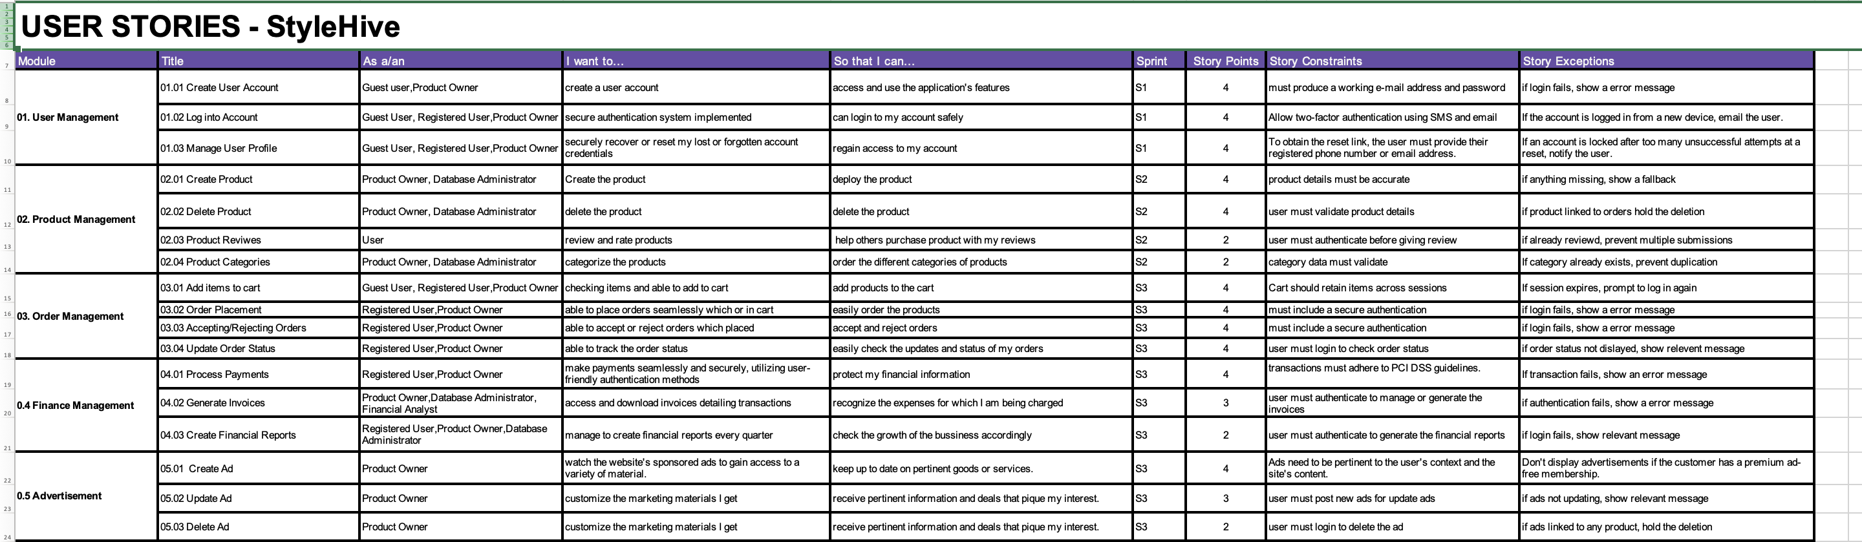
User stories (Avinash)

Slide 7
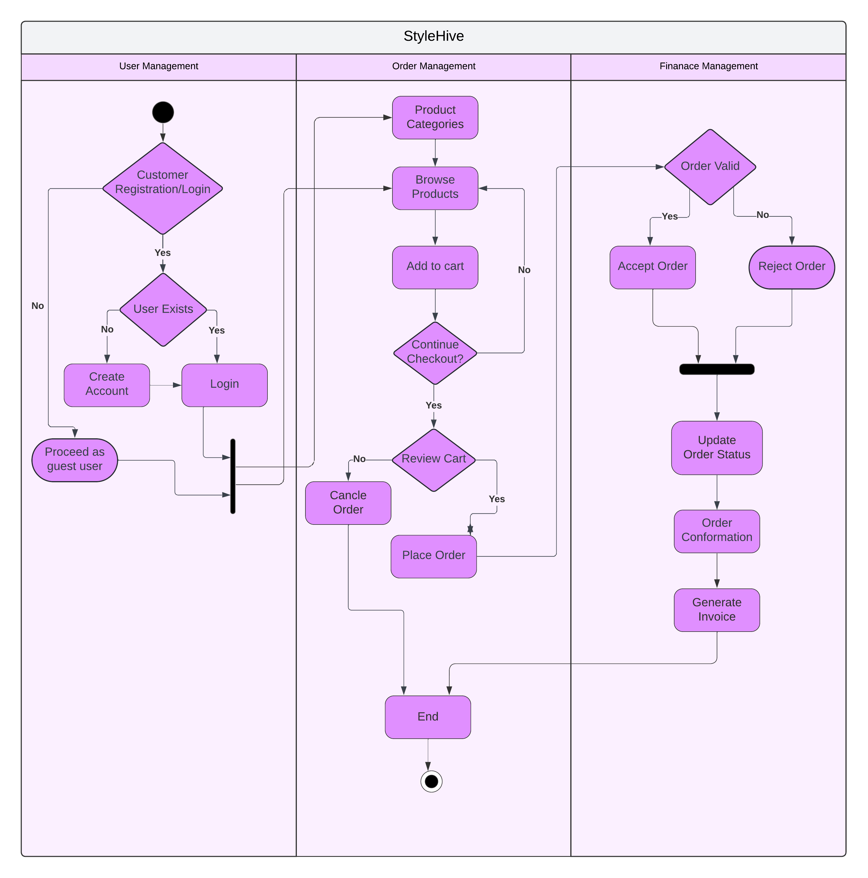
Activity Diagram (Deepak Kumar)

Slide 8
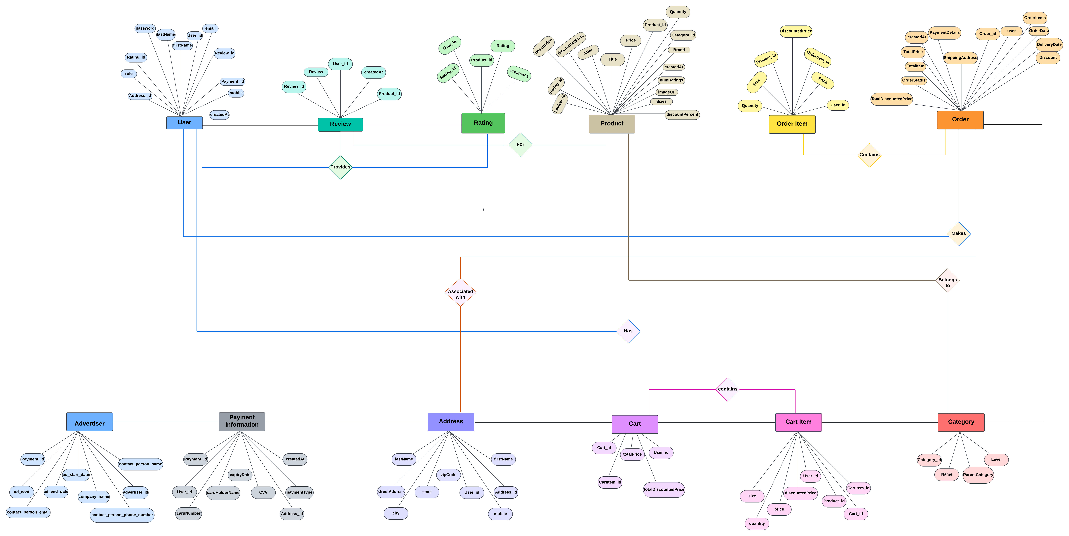
ER DIAGRAM
(Susmitha)

Slide 9
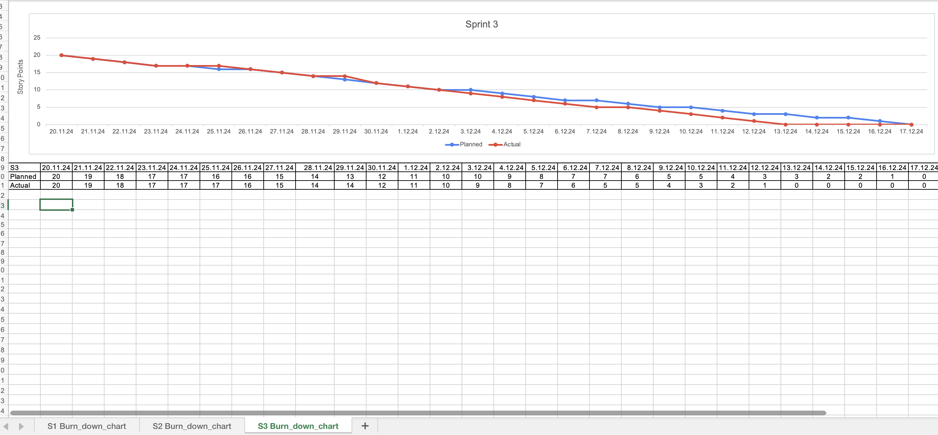
Burndown Chart
(Yeswanth)

Slide 10
Jenkins Report (S3)
(Priyanshu)
Planned Tasks | Completed tasks
Work with the team to prioritize user stories and tasks, balancing impact and effort for maximum value delivery. Create Task Breakdown: Decomposed high-priority backlog items into smaller, actionable tasks to streamline execution. Install Blue Ocean plugin which is a new user experience for Jenkins based on a personalize, modern design that allows users to graphically create, visualize and diagnose Continuous Delivery (CD) Pipelines. Risk Assessment: Identify potential risks and defined mitigation strategies to address them proactively. Implement Grafana Dashboard for visualizing metrics. Organize sessions to onboard the team on new tools, technologies, and process updates planned for Sprint 3. | • Prioritized User Stories: Collaborated with the team to rank user stories and tasks, balancing impact and effort to maximize value delivery. • Installed Blue Ocean plugin as a suite of plugins on an existing Jenkins controller. • Risk Assessment and Mitigation: Identified potential risks such as dependency delays and integration challenges, defining and implementing mitigation strategies to address them proactively. • Installed Grafana Dashboard in my project. • Team Onboarding: Organized and facilitated sessions to onboard the team on new tools, technologies, and process updates planned for Sprint 3.

Slide 11
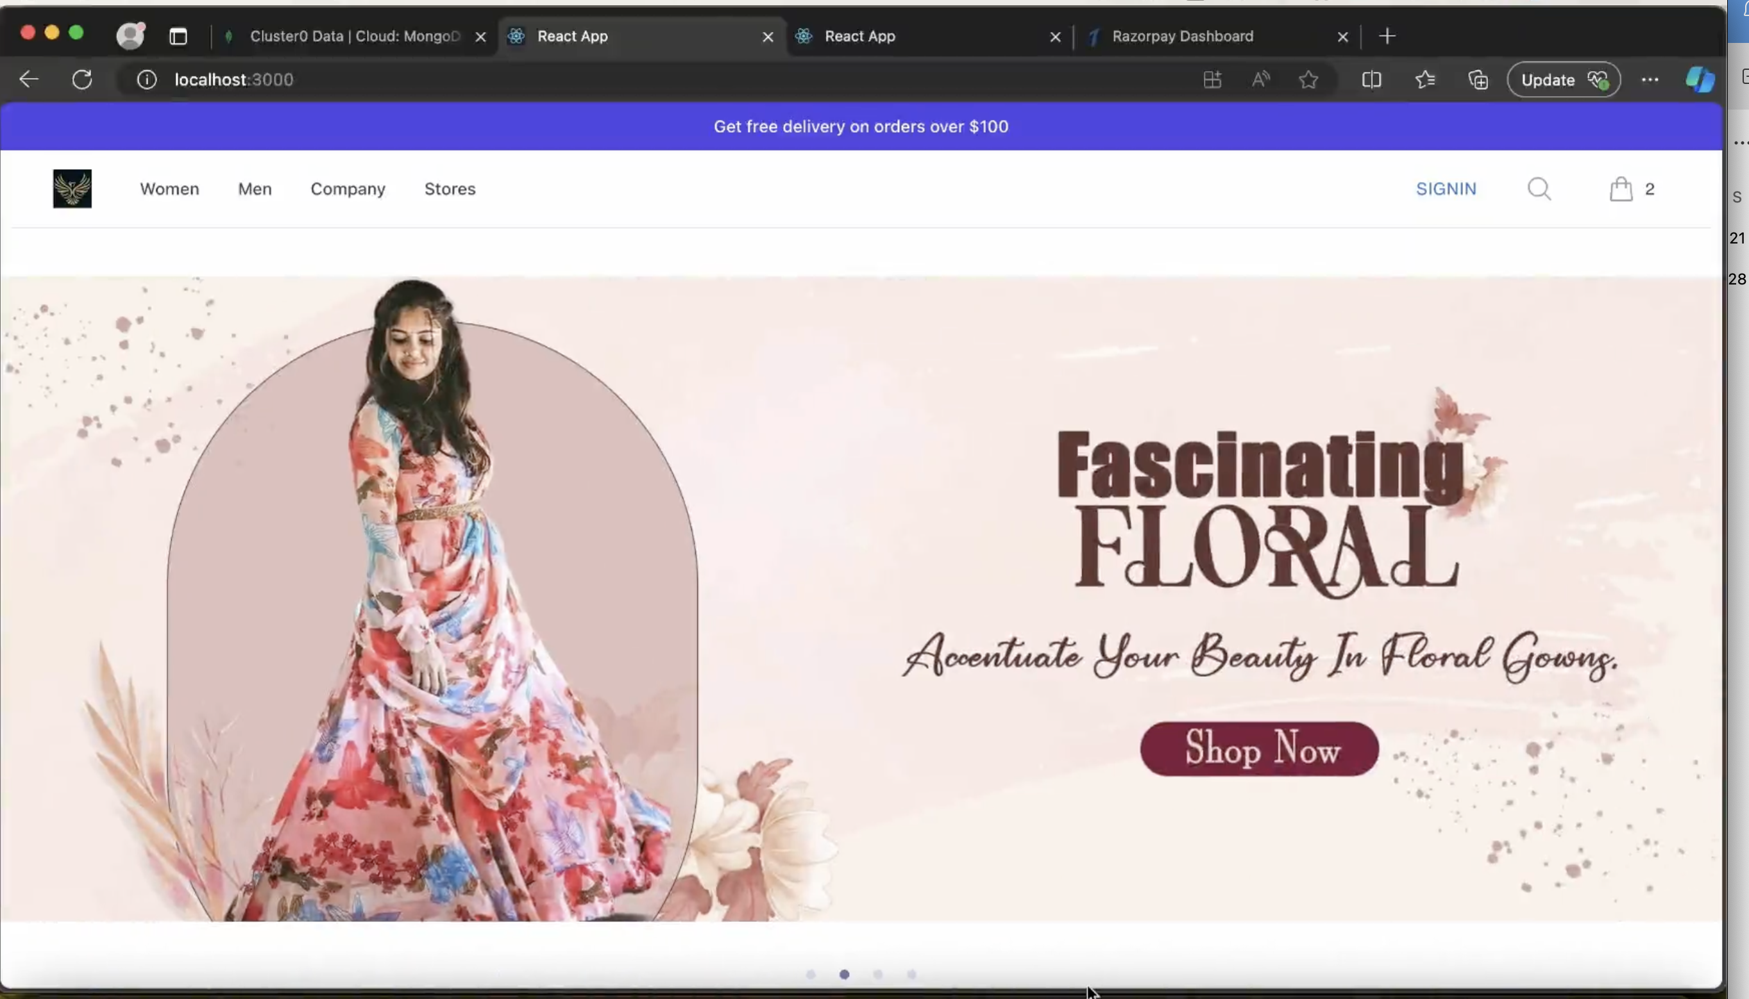
App Demo
(Vyshnav)

Slide 12
Thank you

